Slide 1
Microservices Basic
Lesson 01 : Microservices Basics
Notes:
Add instructor notes here.

Slide 2
Lesson Objectives
In this lesson, you will learn:
What is Service ?
What is Monolithic Architecture
Introduction to Microservice
Emergence of Microservice
Benefits of Microservice Architecture
Diff between Microservice and Monolithic
Challenges in Microservices
Notes:
What is Service ?
What is Monolithic Architecture
Introduction to Microservice
Emergence of Microservice
Benefits of Microservice Architecture
Diff between Microservice and Monolithic
Challenges in Microservices
This lesson is to give an Introduction on Java Server Pages

Slide 3
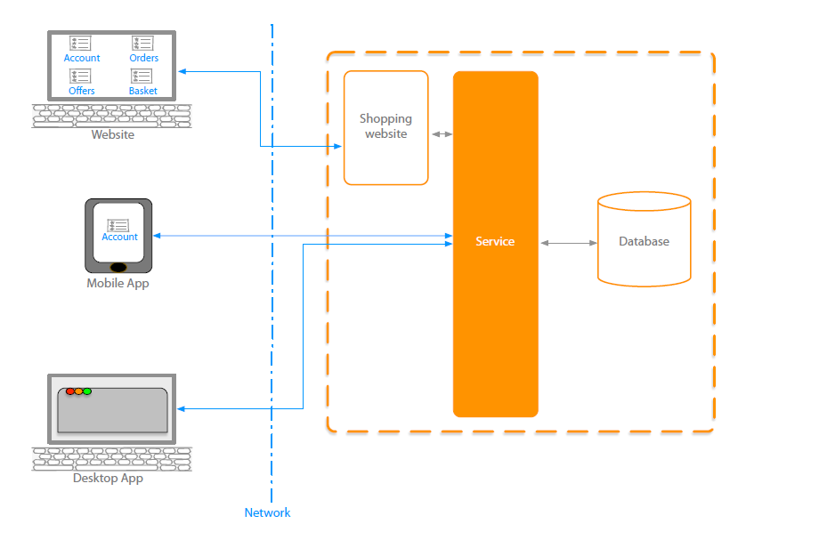
1.1: What is Service ? What is Service ?
Notes:
Service is a piece of SW which provides the functionalities to the other pieces of SW . It could be
CRUD app service
Validation service etc.
Service should be implemented in a SOA where the functionality should be reusable and can communicate to Client application and other services.
Discuss the features of JSP. Explain how a JSP page is processed.

Slide 4
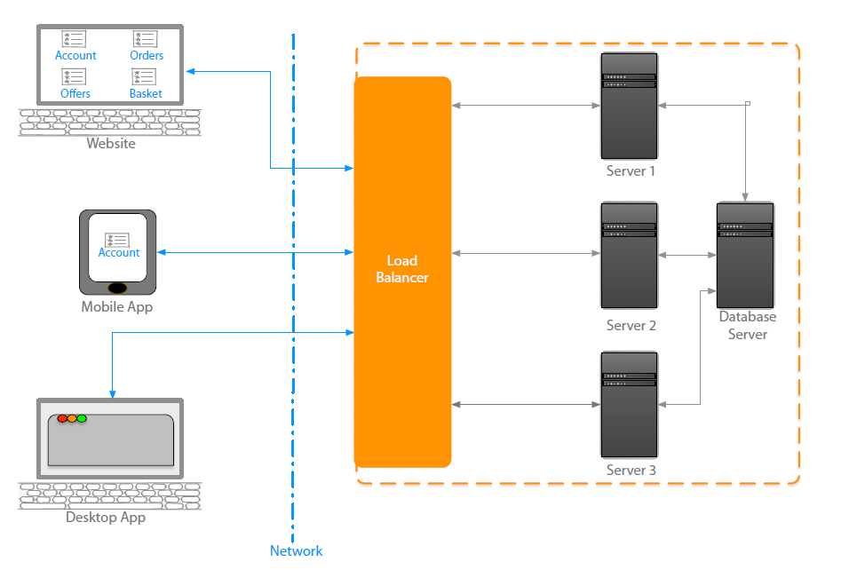
1.1: What is Service ? What is Service – Big picture
In a distributed application , SOA implemented Service can be distributed among multiple server with proper scalability and
can be reuse by any type of application .
Notes:
In a distributed application , SOA implemented Service can be distributed among multiple server with proper scalability and
Can be reuse by any type of application .
When the traffic come for service , then the Load balancer can redirect the traffic to the different server instance where the service is running
We can have multiple instance of the service will be running on Different web server.
The few important characteristics of services are
It is stateless : - Request come for a single service instance doesn’t require to remember the previous request.
It provides a common interface to all type of application where the functionality is declared and encapsulate the implementation from client
When the demand increases , we can increase the number of instances of the service
Discuss the features of JSP. Explain how a JSP page is processed.

Slide 5
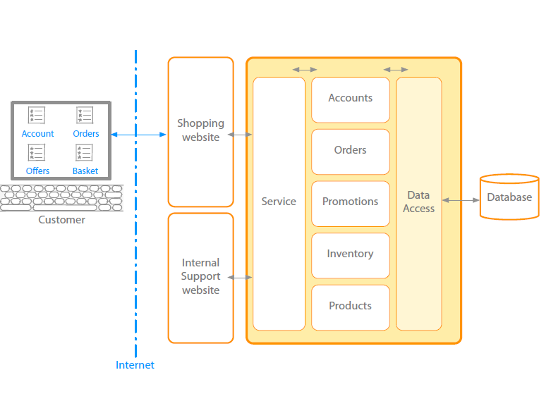
1.2: What is Monolithic Architecture Traditional – Monolithic Architecture
The Monolithic architecture is an architectural style which structures the complete application into one Executable component.

Slide 6
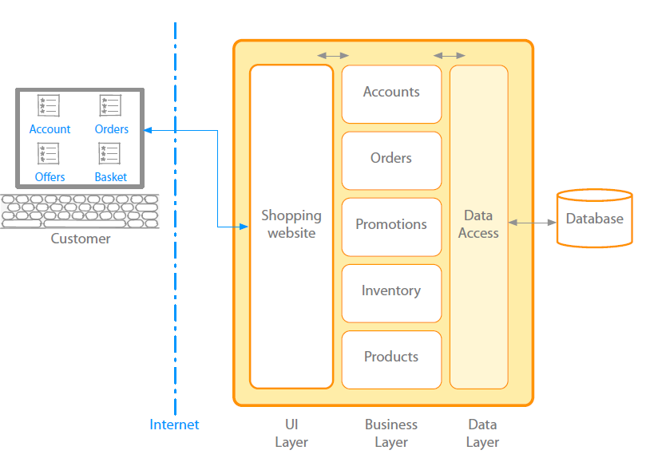
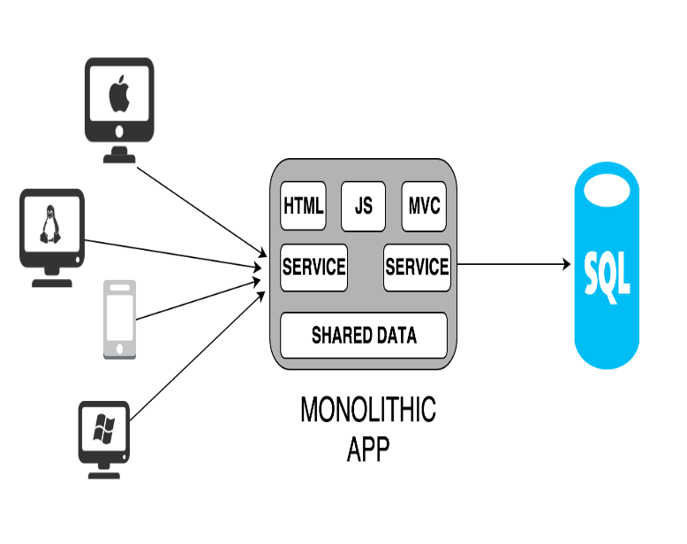
1.2: What is Monolithic Architecture Traditional – Monolithic Architecture
Notes:
It is good for small Application where the below three itility can be easily maintained.
Maintainability
Testability
Deployibility
Monolithic software is designed
to be self-contained; components of the
Program which are interconnected and
interdependent rather than loosely coupled.

Slide 7

1.2: What is Monolithic Architecture Challenges – Monolithic Architecture
A typical enterprise application
No restriction on Size
Large codebase
Longer development times
Inaccessible features
Fixed technology stack
High level of coupling between Modules and services
Failure could effect whole system
Single service on server
Minor change could result in complete rebuild
Notes:
A successful application always try to grow where the Monolithic architecture faced the problem2
Monolithic Architecture is
A typical enterprise application
No restriction on Size
Large codebase
Longer development times
Inaccessible features
Fixed technology stack
High level of coupling between Modules and services
Failure could effect whole system
Single service on server
Minor change could result in complete rebuild
Challenges started where the application became
bigger in size .
Agile development and deployment became very
difficult or may be impossible.
In a tightly-coupled architecture, each component
and its associated components must be present in
order for code to be executed or compiled.
if any program component must be updated, the whole application has to be rewritten

Slide 8
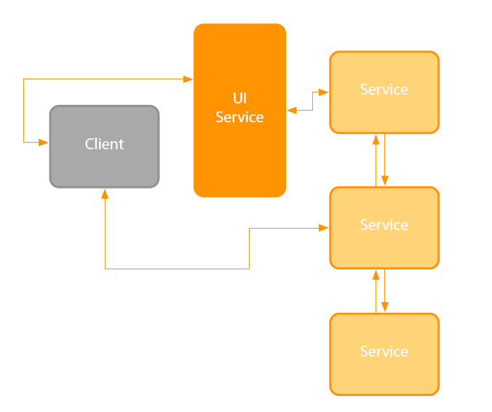
1.3: Introduction to Microservice Architecture Microservice Architecture
This is a kind of architectural style which structures an application as a set of loosely coupled , services organized around the business capabilities.
It is a improved version of Software oriented Architecture
Notes:
SOA done well
•Knowing how to size a service
•Traditional SOA resulted in monolithic services
Micro sized services provide
•Efficiently scalable applications
•Flexible applications
•High performance applications
Application(s) powered by multiple services
Small service with a single focus
Lightweight communication mechanism
•Both client to service and service to service
Technology agnostic API
Independent data storage
Independently changeable
Independently deployable
Distributed transactions
Centralized tooling for management

Slide 9
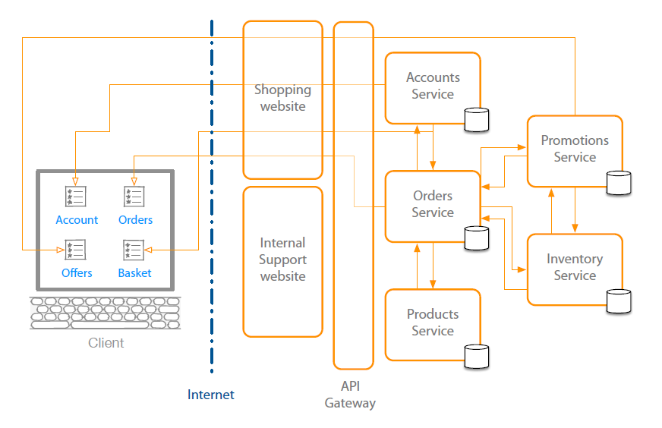
1.3: Introduction to Microservice Architecture Microservice Architecture – Big Picture
.
Notes:
Service is a independently Deployable component and certainly implementing some business rules.
Each service should have its own database which is very important from loos coupling point of view.
Microservices are as per the Business requirement .
One can design small Micro business services independently .
All Microservices are loosely coupled So changes in one will not effect the other Service .
In Implementation view we can have multiple service component .war files.

Slide 10
1.4: Emergence of Microservice Emergence Of Microservices
• Need to respond to change quickly
•Need for reliability
•Business domain-driven design
•Automated test tools
•Release and deployment tools

Slide 11
1.4: Emergence of Microservice Emergence Of Microservices
•On-demand hosting technology
•On-line cloud services
•Need to embrace new technology
•Asynchronous communication technology
•Simpler server side and client side technology

Slide 12
1.5: Benefits of Microservice Architecture Benefits of Microservices
It enables the continuous delivery and deployment of large, complex applications.
Better testability
Better deployibility
It enables you to organize the development effort around multiple teams.
Each team( of 2 to 5 members) owns and is responsible for one or more single service.
Each team can develop, deploy and scale their services independently of all of the other teams
Notes:
Shorter development times
•Reliable and faster deployment
•Enables frequent updates
•Decouple the changeable parts
•Security
•Increased uptime
•Fast issue resolution
•Highly scalable and better performance
•Better ownership and knowledge
Right technology
•Enables distributed teams

Slide 13
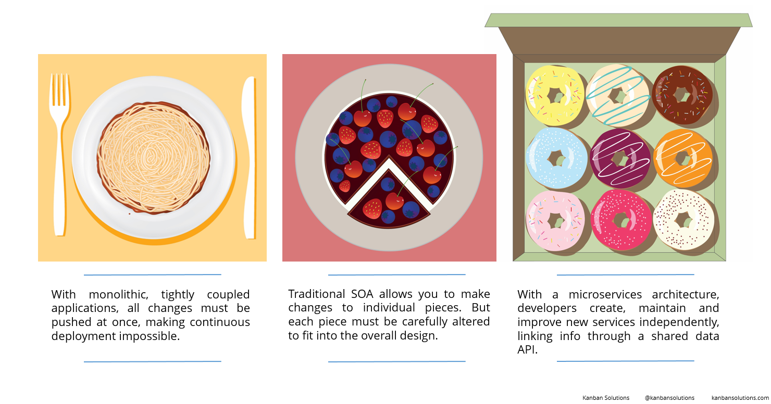
1.5: Benefits of Microservice Architecture Benefits of Microservices
Notes:
Shorter development times
•Reliable and faster deployment
•Enables frequent updates
•Decouple the changeable parts
•Security
•Increased uptime
•Fast issue resolution
•Highly scalable and better performance
•Better ownership and knowledge
Right technology
•Enables distributed teams

Slide 14
1.5: Benefits of Microservice Architecture Benefits of Microservices
Each Microservice is relatively small.
For Developer , it is easy to understand
Because of small size ,the IDE is faster making developers more productive
The application starts faster which makes the developer speeds up the deployment .
It allows the easy and flexible way to integrate automatic deployment with Continuous integration tools(Jenkin , Hudson etc.)
It improved fault isolation.
Eliminates any long-term commitment to a technology stack
Notes:
Enables the continuous delivery and deployment of large, complex applications.
Better testability - services are smaller and faster to test
Better deployability - services can be deployed independently
It enables you to organize the development effort around multiple, auto teams. It enables you to organize the development effort around multiple teams. Each (two pizza) team is owns and is responsible for one or more single service. Each team can develop, deploy and scale their services independently of all of the other teams.
Each microservice is relatively small
Easier for a developer to understand
The IDE is faster making developers more productive
The application starts faster, which makes developers more productive, and speeds up deployments
Improved fault isolation. For example, if there is a memory leak in one service then only that service will be affected. The other services will continue to handle requests. In comparison, one misbehaving component of a monolithic architecture can bring down the entire system.
Eliminates any long-term commitment to a technology stack. When developing a new service you can pick a new technology stack. Similarly, when making major changes to an existing service you can rewrite it using a new technology stack.

Slide 15
1.5: Benefits of Microservice Architecture Benefits of Microservices
It has code for Business logic only ,no mixup with Html,CSS and other UI components
It can be deployed on commodity hardware or low/medium configuration server.
Easy to integrate with 3rd party service.
Each microservice has it’s own Database but it depends upon requirement .One can use common DB i.e. Oracle , mySql for all service.

Slide 16
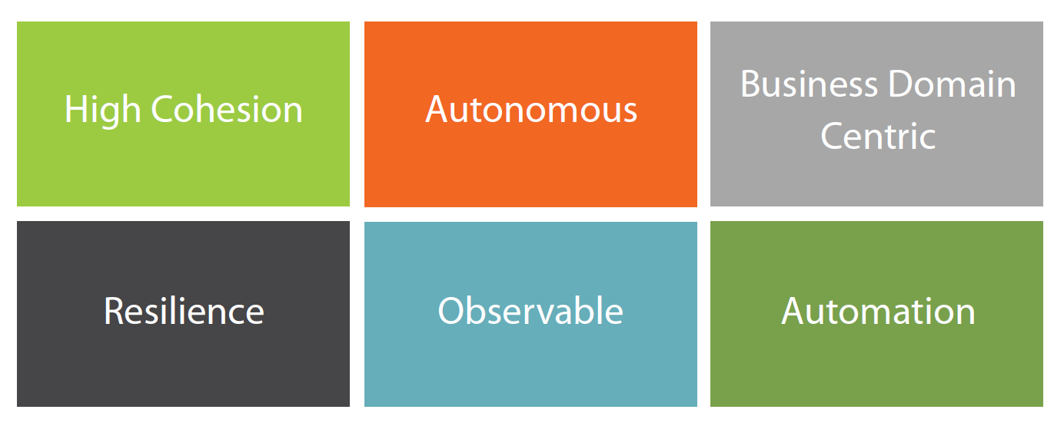
1.5: Benefits of Microservice Architecture Microservices Design principle

Slide 17
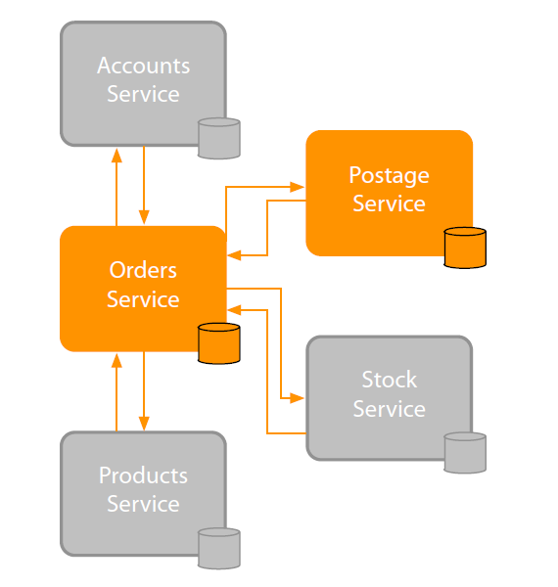
1.5: Benefits of Microservice Architecture Microservices Design principle – High Cohesion
It gives you scalability , flexibility and Reliability
Notes:
Single focus
Single responsibility
•SOLID principle
•Only change for one reason
•Reason represents
•A business function
•A business domain
•Encapsulation principle
•OOP principle
•Easily rewritable code
Why
•Scalability
•Flexibility
•Reliability

Slide 18
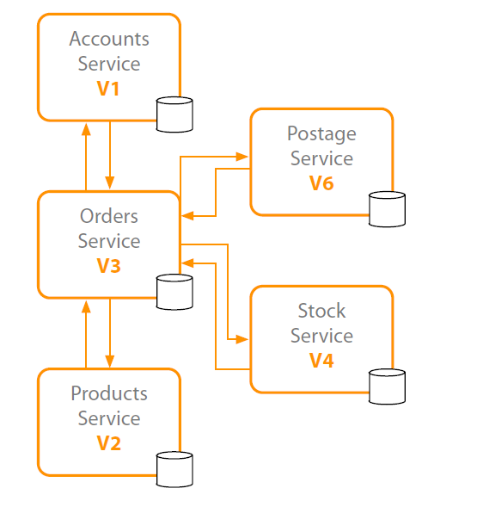
1.5: Benefits of Microservice Architecture Microservices Design principle - Autonomous
Loose Coupling
Stateless
Concurrent development
Notes:
Loose coupling
•Honor contracts and interfaces
Stateless
Independently changeable
Independently deployable
Backwards compatible
Concurrent development

Slide 19
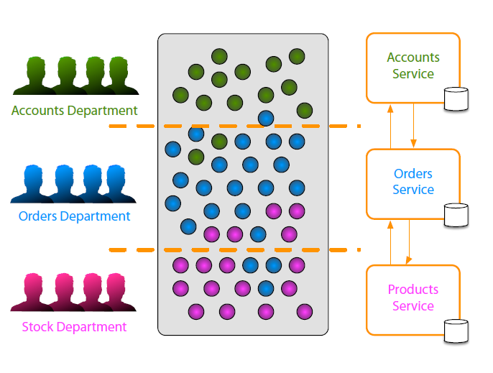
1.5: Benefits of Microservice Architecture Microservices Design principle - Business Domain centric
Service represents business function
Scope of service
Responsive to Business change
Notes:
Service represents business function
•Accounts Department( Specific SW code for Accounting related )
•Postage calculator ( Business functionality)
Scope of service
Bounded context from DDD(Domain Driven Design)
Identify boundaries\seams
Shuffle code if required
•Group related code into a service
•Aim for high cohesion
Responsive to business change( Based 0n Business change , microservice also change accordingly)

Slide 20
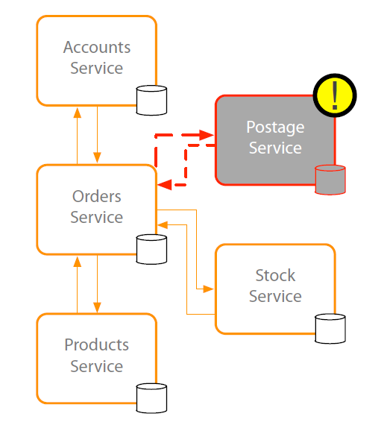
1.5: Benefits of Microservice Architecture Microservices Design principle - Resilience
If one service fails , It didn’t disturb the process of other system
Design for known failure
Degrade functionality on failure detection
Default functionality on failure detection
Notes:
Embrace failure
•Another service
•Specific connection
•Third-party system
Degrade functionality
Default functionality
Multiple instances
•Register on startup
•Deregister on failure
Types of failure
•Exceptions\Errors
•Delays
•Unavailability
Network issues
•Delay
•Unavailability
Validate input
•Service to service
•Client to service

Slide 21
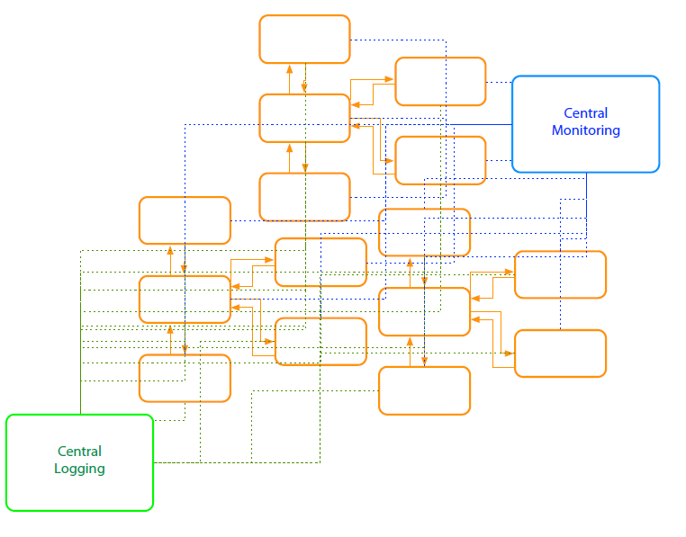
1.5: Benefits of Microservice Architecture Microservices Design principle - Observable
Centralized Monitoring
Real time monitoring
Monitor The host
CPU , Memory , Disk usage etc
.
Expose Metrics within the service
Notes:
System Health
•Status
•Logs
•Errors
Centralized monitoring
Centralized logging
Why
•Distributed transactions
•Quick problem solving
•Quick deployment requires feedback
•Data used for capacity planning
•Data used for scaling
•What's actually used
•Monitor business data

Slide 22
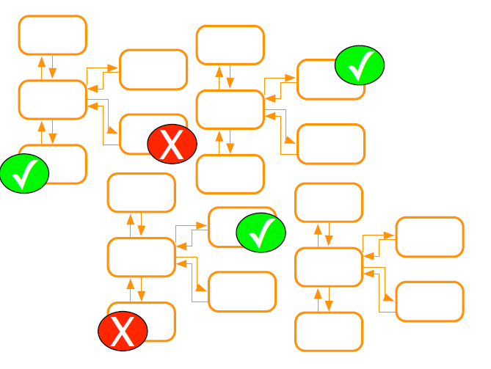
1.5: Benefits of Microservice Architecture Microservices Design principle - Automation
It use tools to do testing and provide feedback automatically
CI tools
Work with Source control system
Automatic after check in
Unit testing and Integration testing
required for production code.
Notes:
Tools to reduce testing
•Manual regression testing
•Time taken on testing integration
•Environment setup for testing
Tools to provide quick feedback
•Integration feedback on check in
•Continuous Integration
Tools to provide quick deployment
•Pipeline to deployment
•Deployment ready status
•Automated deployment
•Reliable deployment
•Continuous Deployment
Why
•Distributed system
•Multiple instances of services
•Manual integration testing too time consuming
•Manual deployment time consuming and unreliable

Slide 23
1.6: Diff between Microservice and Monolithic Microservice Vs Monolithic
Monolithic | Microservices
Single deployment | Every microservice is a separate deployment. Many more modules with specific functionality and it ensures Module independency.
This type of application puts all its functionality into a single process. | This architecture puts each element of its functionality into a separate service.
Single codebase | More than one code base
Interaction between classes are synchronous

Slide 24
1.6: Diff between Microservice and Monolithic Microservice Vs Monolithic
Monolithic | Microservices
The whole app has one DB. | Every microservice has its own DB.
It scales by replicating the monolith on multiple servers | It scales by distributing these services across servers and replicating as needed.
Any changes in application requires a full redeploy | It is loosely coupled, any changes in one service will not effect another service.
Hard to work with multiple teams | It is easy , as the size of the service is small and independent.
If the application is big then Hard to manage | It separate deployment ,separate monitoring

Slide 25
1.6: Diff between Microservice and Monolithic Microservice Vs Monolithic
Monolithic | Microservices
Continuous deployment is difficult . | Continuous deployment is easy.
Bug in any module (e.g. memory leak) can potentially bring down the entire process. Here all instances of the application are identical , so that bug will impact the availability of the entire application. | Bug in one service can only effect that service. It can’t effect other service.
Monolithic applications has a barrier to adopting new technologies. | Microservice supports to adopt the new technology.

Slide 26

1.6: Challenges in Microservices Challenges / Drawbacks - Microservices
Challenges
It brings a lot of operation overhead.
Because of distributed deployment , default to trace problem.
Complicated to manage whole products where number of services
increase.
Drawbacks
Developer tools/IDEs are oriented on building monolithic applications and don’t provide explicit support for developing distributed applications.
The microservice architecture replaces N monolithic application instances with NxM services instances. If each service runs in its own JVM (or equivalent), which is usually necessary to isolate the instances, then there is the overhead of M times as many JVM runtimes.

Slide 27
1.3: Introduction to Microservice Architecture Microservices implementation stack
Spring Boot and Spring cloud
Microservice with Python
Microservice with PHP
Prometheus Microservices
Netflix Microservices Monitoring
Fabric 8
Dropwizard
Netty
jackson

Slide 28
Summary
In this lesson, you have learnt:
What is Service ?
What is Monolithic Architecture
Introduction to Microservice
Emergence of Microservice
Benefits of Microservice Architecture
Diff between Microservice and Monolithic
Challenges in Microservices

Slide 29
Review – Questions
Question 1: _____ is a piece of SW which provides the functionalities to the other pieces of SW
Question 2: _________ architecture is an architectural style which structures the complete application into one Executable component .
Question 3: Service is Stateless .
True
False
Notes:
1.Service
2.Monolithic
3.True
Answers for the Review Questions:
Answer 1: Service
Answer 2: Monolithic service
Answer 3: True

Slide 30
Review – Questions
Question 4: _________ architecture is a Service-oriented architecture, that is composed of loosely coupled elements that have bounded contexts.
Question 5: Which of the followings important ilities which directly impact on development velocity
scalability
Deployibility
Maintainability
All of the above
Question 6: Which of the followings are the microservice implementation stack
Spring boot
Netflix Microservices Monitoring
All of the above
Notes:
4.Microservice
5.All
6.Spring boot
Answers for the Review Questions:
Answer 4: Microservice
Answer 5: All of the above
Answer 6: All of the above

